Slide 1


Here's your outline to get started
Key facts about your topic
Dairy cattle are cattle cows bred for the ability to produce large quantities of milk, from which dairy products are made. Dairy cows generally are of the species Bos taurus. Historically, there was little distinction between dairy cattle and beef cattle, with the same stock often being used for both meat and milk production. Today, the bovine industry is more specialized and most dairy cattle have been bred to produce large volumes of milk.
Height: 58 in (147 cm) (Female)
Weight: 1,279 lb (580 kg) (Female), 1,191 lb (540 kg) - 1,808 lb (820 kg) (Male)
Breeds: Holstein Friesian cattle, Jersey cattle, Brown Swiss, Guernsey cattle, Ayrshire cattle, Sahiwal cattle, Australian Friesian Sahiw...
See more: Open the Notes below for more information.
Notes:
QuickStarter has created an outline to help you get started on your presentation. Some slides include information here in the notes to provide additional topics for you to research.
More key facts:
Breeds: Holstein Friesian cattle, Jersey cattle, Brown Swiss, Guernsey cattle, Ayrshire cattle, Sahiwal cattle, Australian Friesian Sahiwal, Alderney cattle, Australian Milking Zebu, Swedish Red-and-White, Jamaica Hope, German Black Pied cattle, Abigar, Illawarra cattle, Bretonne Pie Noir, Murnau-Werdenfels Cattle, Lineback cattle, Icelandic cattle, Vechur Cattle, Belgian Red cattle

Slide 2

Related topics to research
Dairy farming
Mastitis in dairy cattle
Automatic milking
Bovine somatotropin
Milk fever
Cow-calf operation
Draft horse
Bulk tank
House cow
Milking pipeline
Use Smart Lookup to learn more
1
Highlight one of the related topics
Right-click on the topic
Choose "Smart Lookup"
2
3

Slide 3
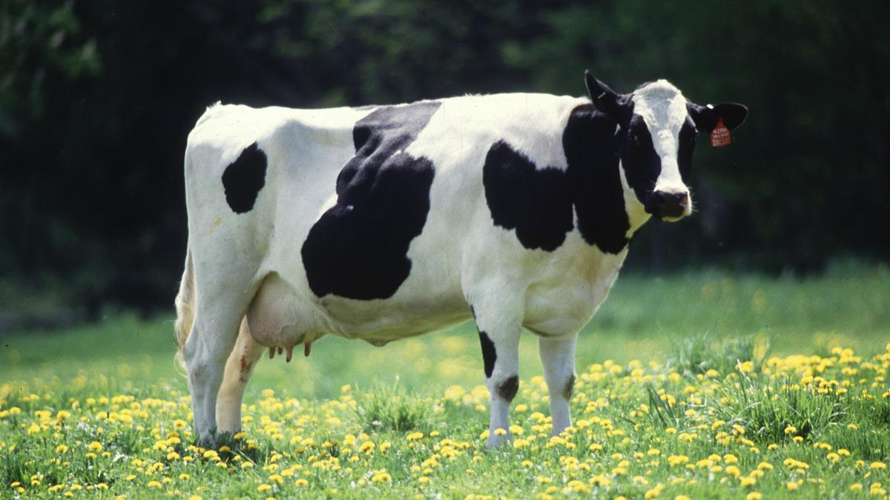
Management of farm animals
DAIRY

Slide 4
What is dairy farming management?
Dairying is the management of animals for milk and its products for human consumption. In dairy farm management, we deal with processes and systems that increase yield and improve quality of milk.
Milk yield is primarily dependent on the quality of breeds in the farm. Selection of good breeds having high yielding potential (under the climatic conditions of the area), combined with resistance to diseases is very important.
For the yield potential to be realised the cattle have to be well looked after – they have to be housed well, should have adequate water and be maintained disease free.
The feeding of cattle should be carried out in a scientific manner – with special emphasis on the quality and quantity of fodder. Besides, stringent cleanliness and hygiene (both of the cattle and the handlers) are of paramount importance while milking, storage and transport of the milk and its products.
This Photo by Unknown Author is licensed under CC BY

Slide 5
Contents
Pasture Managment
01
Sanitation and hygiene
02
Reproduction
03
Animal welfare
04

Slide 6
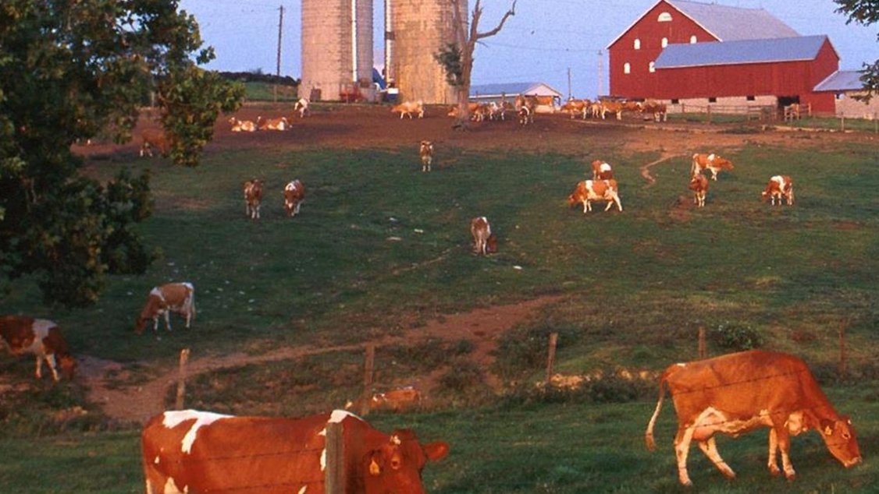
PASTURE MANAGMENT
Good pasture management is one of the most important aspects of successful dairy production. Once an improved grass-legume pasture is established it can remain productive and weed free, providing large amounts of good quality feed for dairy cows, bulls, and young stock for many years. This will occur so long as the person managing the farm follows some simple rules, as follows:
Stocking rate [SR]
Maintaining the appropriate stocking rate is perhaps the most important rule of pasture management. The right stocking rate will vary from farm to farm, depending on;
- soil fertility
- annual rainfall and its distribution
- whether the pasture is shaded or unshaded
- pasture variety (improved Vs unimproved)
- use of fertiliser
- pests and diseases of the pasture

Slide 7
Sanitation and hygiene It is the processes of adopting hygienic measures which nullifies the factors of health deterioration and create conditions to secure health and ensure production of good quality products.
Problems Due to Inadequate Sanitation:
Various problems in practical implementation for prevention of diseases are due to the fact that the majority of livestock is managed by illiterate and ignorant persons who ignore the basic principles of hygiene and sanitation. Majority of causes for spread of diseases could be ascribed to improper sanitation which gives shelter to carriers of germs.
Importance:
Proper cleaning and sanitation removes most of germs and parasites along with dirt, thereby remaining germs are few in number and possibly in weaken condition so as to be harmless under ordinary conditions.
:

Slide 8
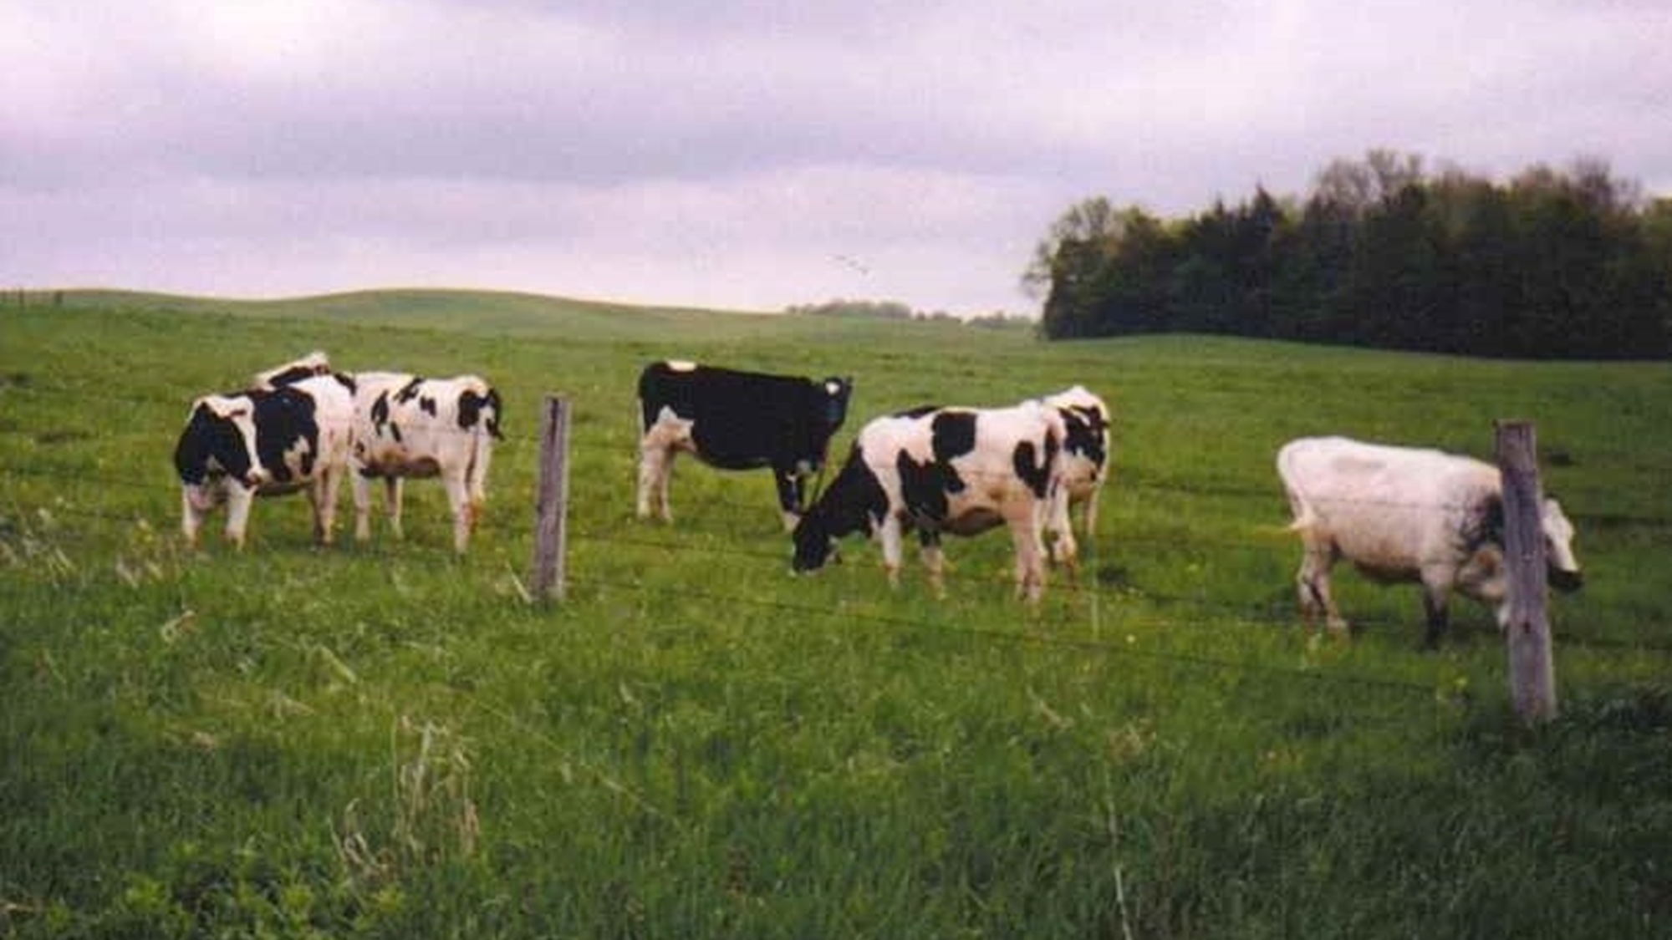
Main importance of sanitation
1. Proper sanitation discovers causes of all preventable diseases.
2. It helps to devise means of rendering the causes ineffective if not removal of the causes of spread of diseases.
3. Helps in providing the most favorable conditions of life in respect of water, air, well sanitized sheds, etc.
4. Helps in increasing the efficiency of animals.
5. Prevents economic losses due to infection.
6. Helps in development and growth of animals, makes life vigorous and productive.
7. Lowers the rate of mortality and increases the longevity of animals.
8. Prevents occurrence of disease and establishes conditions that ensure preservation of health.

Slide 9
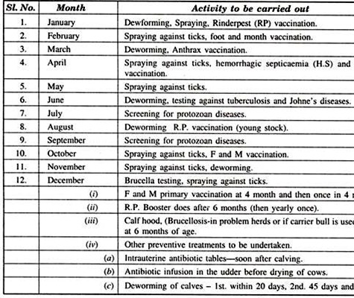
Control of Disease Outbreak:
Control of disease outbreak is simplified by observing the following recommendations:
1. Segregation of sick animals.
2. Change of pastures.
3. Vaccination of healthy animals.
4. Proper disposal of litter material by burning.
5. Bury/burn infected carcass for proper disposal.
6. Clean and disinfection of premises-contaminated by diseased animals.
7. Consult qualified veterinarian for diagnosis.
8. Do not rely on untrained persons for the diagnosis of diseases.
9. Prompt report to district livestock authorities about the outbreak.
10. Quarantine.
11. While waiting for the diagnosis, put a disinfectant in the drinking water to prevent transmission of germs through water.
12. Use only proper approved methods of sanitation and treatments.
13. Make regular use of foot bath for animals and employees.

Slide 10
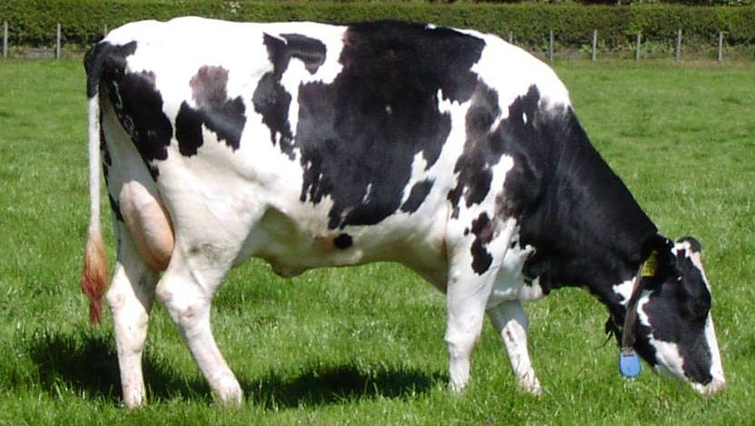
Reproduction.
Reproductive efficiency is very important for profitable and sustainable operation of a commercial livestock production. Management, including genetic selection and nutrition, is critical to good reproductive performance. Replacement females should be productive, and reach puberty early. Fertility is maximized when well-managed females are bred with high-quality semen delivered at the appropriate time and place. Since the genetic value and fertility of each male is typically much more important than that of each female, breeding males should have superior genetics and good reproductive performance.
Breed characteristics of high yielding dairy cows
Attractive individuality with feminity, vigour, harmonious blending of all parts, impressive style and carriage
Animal should have wedge shaped appearance of the body
It should have bright eyes with lean neck
The udder should be well attached to the abdomen
The skin of the udder should have a good network of blood vessels
All four quarters of the udder should be well demarcated with well placed teats.
Notes:
Consider talking about:
Cow comfort and its effects on milk production

Slide 11
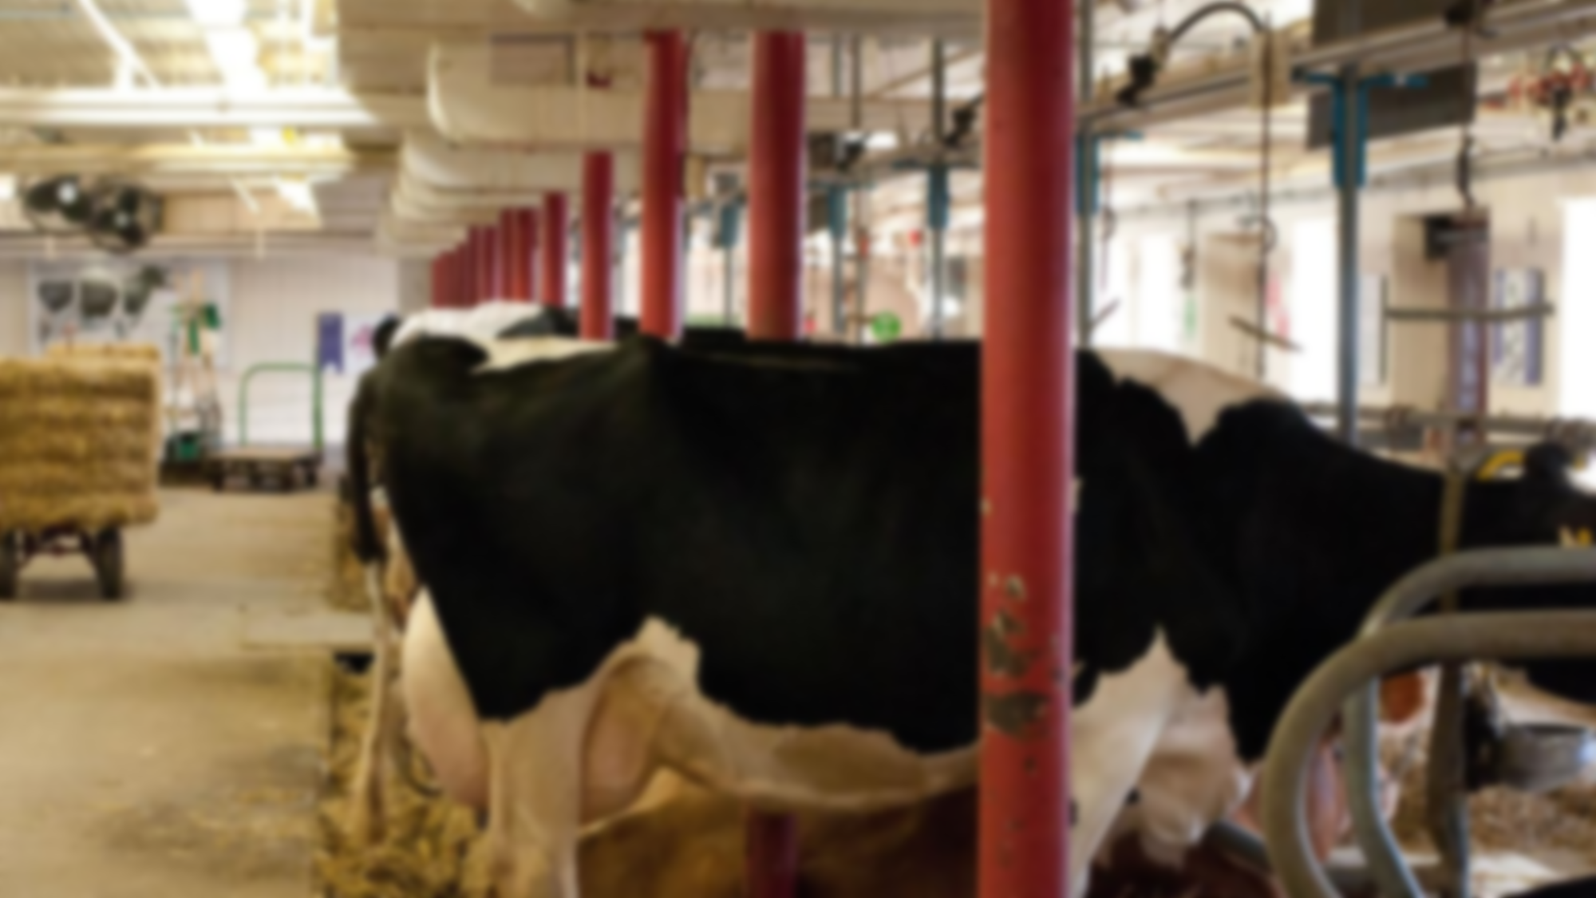
Animal welfare
ANIMAL WELFARE:
Goals for a Successful Calf Management System
Building the immune system of the calf as soon as possible after birth.
Reduce stress and microbial challenges to the calf.
Provide adequate nutrition
Provide proper treatments for sick calves.
Immediate care of the calf after birth
Clean away mucous from the nose and the mouth.
Make sure that breathing is initiated, especially after difficult birth. This can be done by tickling the nose or by pouring cold water on the calf's head, which causes the grasping reflex in the calf.
Examine the calf for injuries and birth defects.
Dry the calf if the cow is not allowed to do so (e.g. in case of Johne's disease).
Feed ample amounts of colostrum as soon as possible within the first hour after birth. Use a nipple bottle if necessary. Provide a second feeding within 12 hours of birth.
Separate the calf from the cow within the first 12 hours of birth after the cow has dried the calf and the calf has nursed. Separate the calf immediately after birth if there is any concern of infectious diseases such as Johne's disease.
Dip or coat the navel with 7% tincture of iodine.
Make sure the calf in properly identified.

Slide 12

THANKYOU!! Slide made by FYJC SCIENCE,G ROLL NO.101-105. 1)kreteka Agrawal 2)Sabina Ansari 3)Neeraj Appari 4)Diya Bakshi 5)Siddhant chaurasia

